Slide 1
Risk
Advanced Programming Practices
Team 21:
Yash Sheth, Samip Thakkar, Divyansh Thakar, Harsh Vaghani and Mahy Salama

Slide 2
Features of Build 3
User driven creation of map elements.
User can edit and save downloaded map file as per the format.
User can load existing map file or create from scratch.
Verification of map correctness upon loading and before saving.(Successfully loads the 3dCliff.map and World.map file. Reject loading of the TwinVolcano.map)

Slide 3
Features of Build 3
Implementation of “phase view” according to Observer pattern.
Implementation of “player world domination view”
Implementation of the different player behaviors using the Strategy pattern.
Single Game mode: Game starts by user selecting map and it is loaded as connected graph. User is allowed to select number of players and then players are assigned countries randomly.

Slide 4
Features of Build 3
Tournament Mode: When the game starts, if an option for a Tournament Mode is selected the tournament proceeds without any user interaction and show the results of the tournament at the end.
Startup Phase: All countries are randomly assigned to players. Players are allocated a number of initial armies, depending on the number of players. In round-robin fashion.

Slide 5
Features of Build 3
Reinforcement phase: Calculation of correct number of reinforcement armies according to the Risk rules. Implemented “card exchange view” using the Observer pattern.
Attack Phase: Player can declare an attack by selecting attacker and attacked country.Attacker and attacked player decide how many dice to roll. If defender is conquered, attacker can move any number of its armies in the conquered country. If it results in conquering the whole map, the attacker is declared the winner and the game ends.

Slide 6
Features of Build 3
Fortification phase: Implemented valid fortification move according to the Risk rules. Fortification ends automatically when the armies have been moved.
Game Save/Load: As a game is being played, the user is allowed to save the game in progress to a file, and allow the user to load the game in exactly the same state as saved.

Slide 7
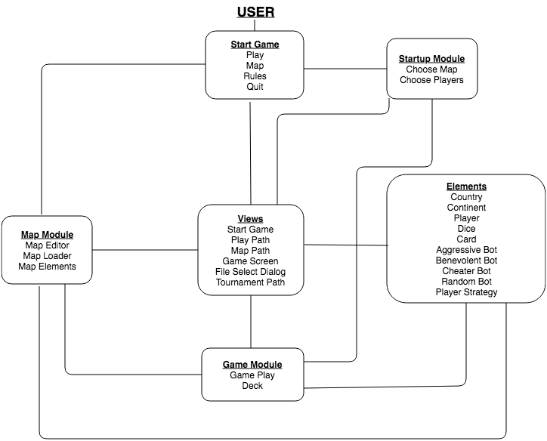
Architectural Design

Slide 8
Technology Used
This project is completely build in Java.
Backend
Java
Frontend
Java Swing

Slide 9
Thank You

